Slide 1
Leona an android app

Slide 2
INTRODUCTION
The main aim of this application is to show all the Restaurents near by our location based upon user selected range.
Then our application will show all the Food items which is available in that selected Restaurent and correspoding discounds which is provided at that Restaurent in timely manner.
This Application will shows available discounts to the users in timely Manner based on their Preferences.
It has a great potential to engage numerous business owners as well as potential customers in the same place.
This is what a Lioness (Leona) does when is hungry and needs food for her family.

Slide 3
SOFTWARE AND HARDWARE REQUIREMENTS
SOFTWARE REQUIREMENTS:
Operating System : Windows 10.
Programming Package : Android studio.
HARDWARE REQUIREMENTS:
Ram : 500Mb.
Hard Disk : 24Gb.
Input device : Standard Keyboard and Mouse.
output device : Smartphone,Laptop.

Slide 4
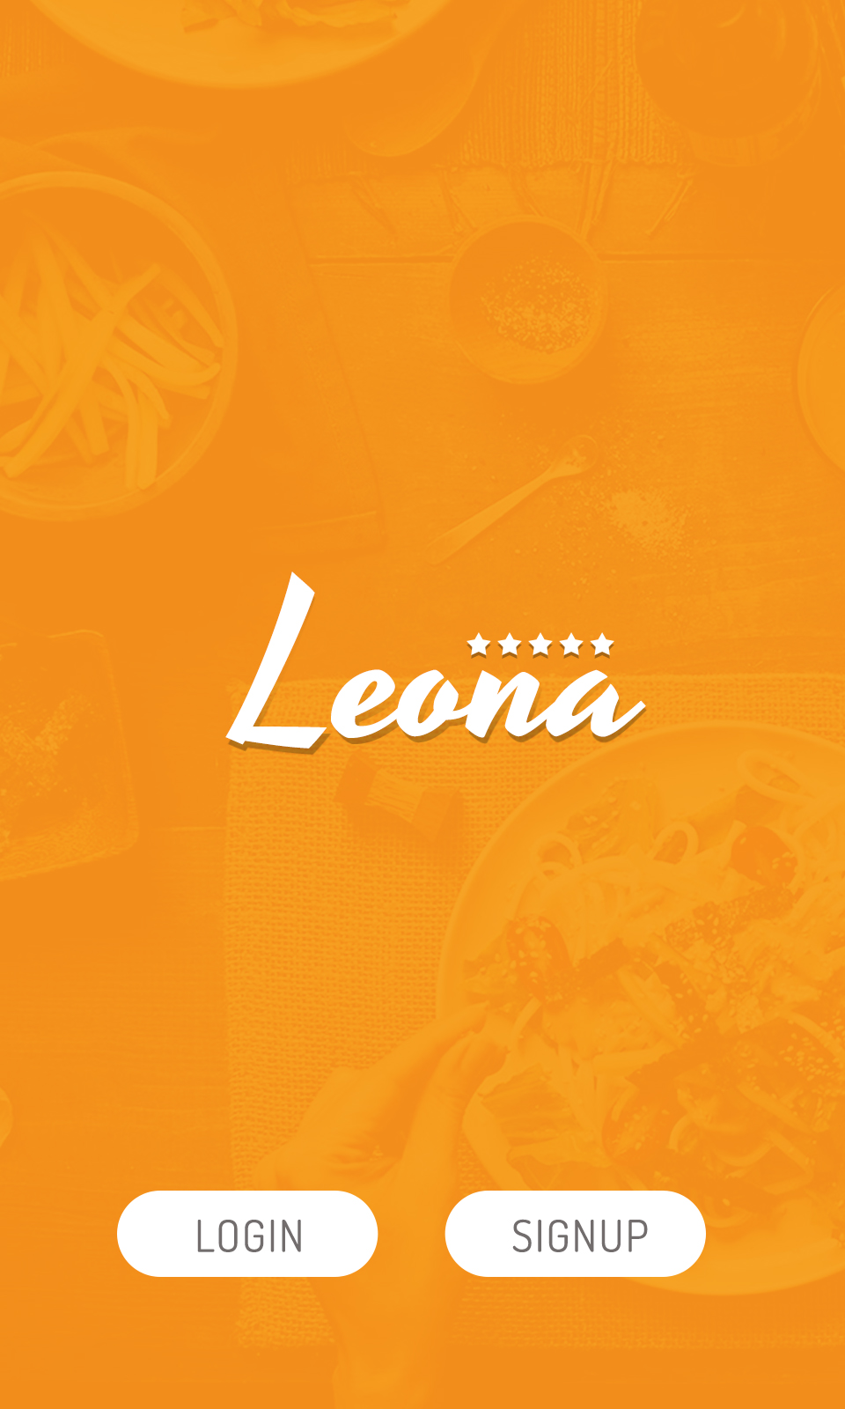
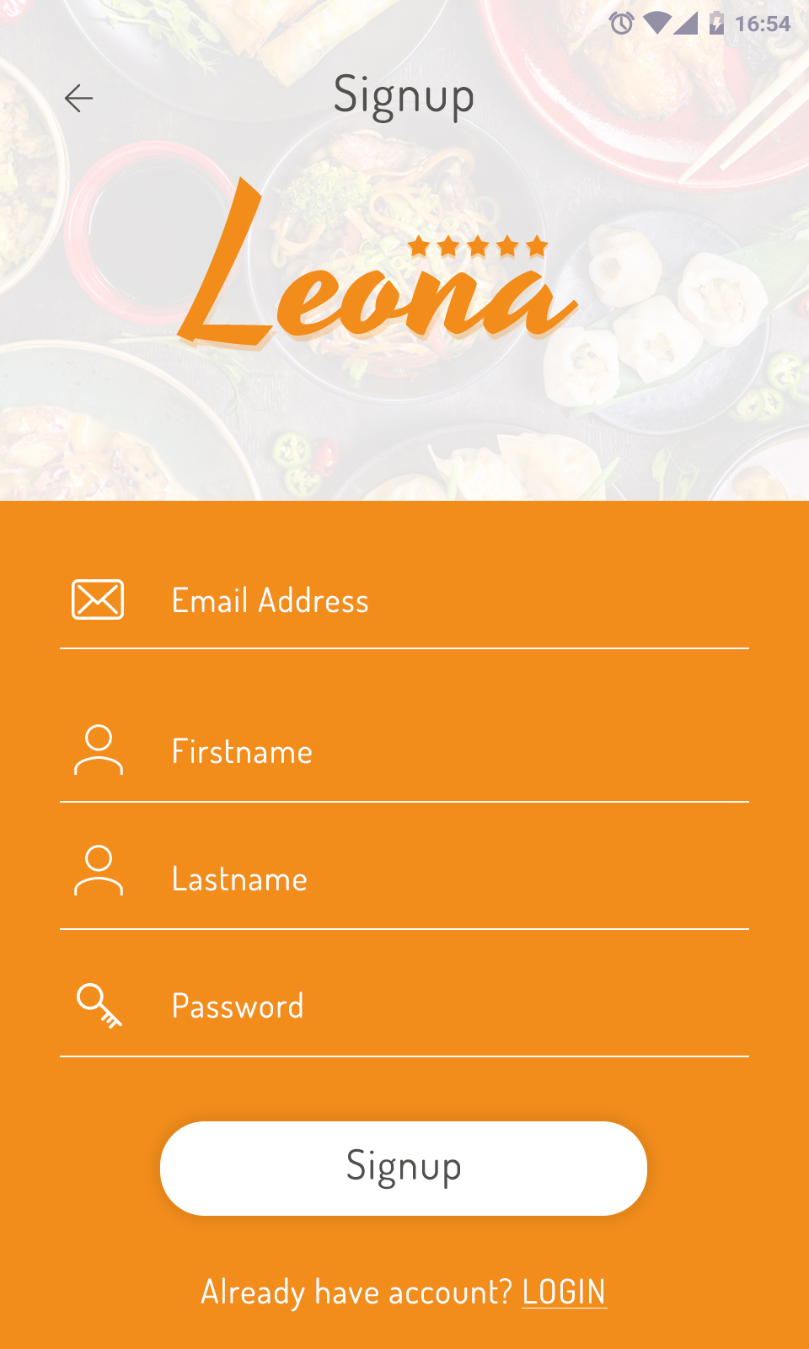
Welcome screen
Signup

Slide 5
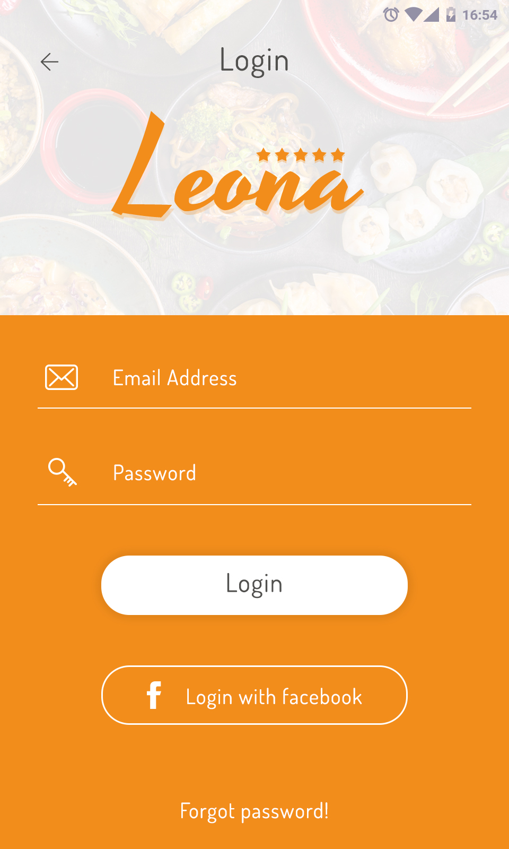
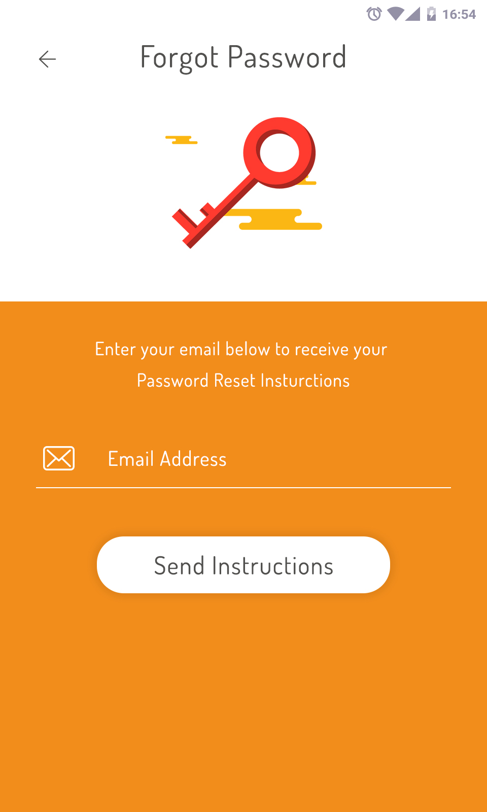
Login Screen
Forgot Screen

Slide 6
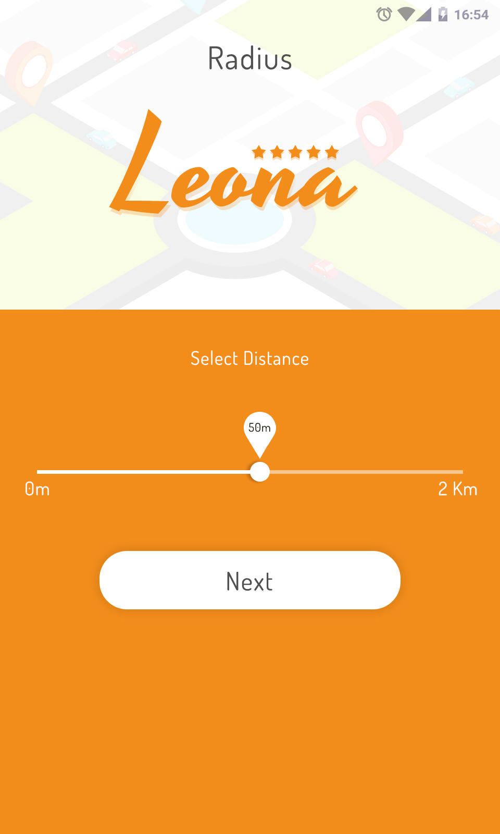
Preferences Screen
Distance Screen

Slide 7
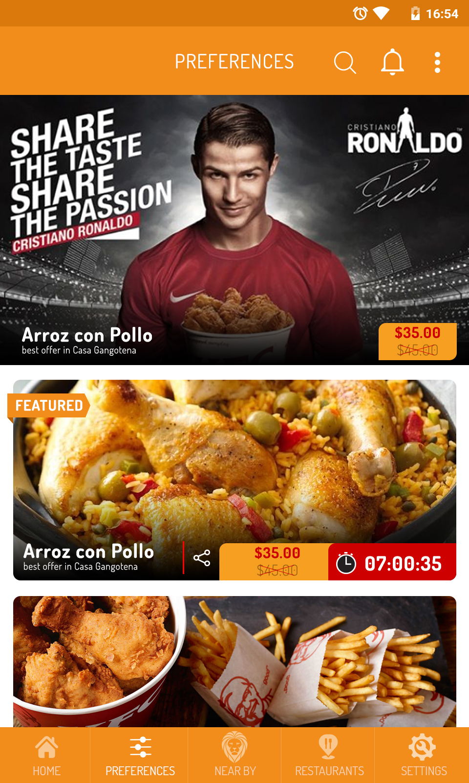
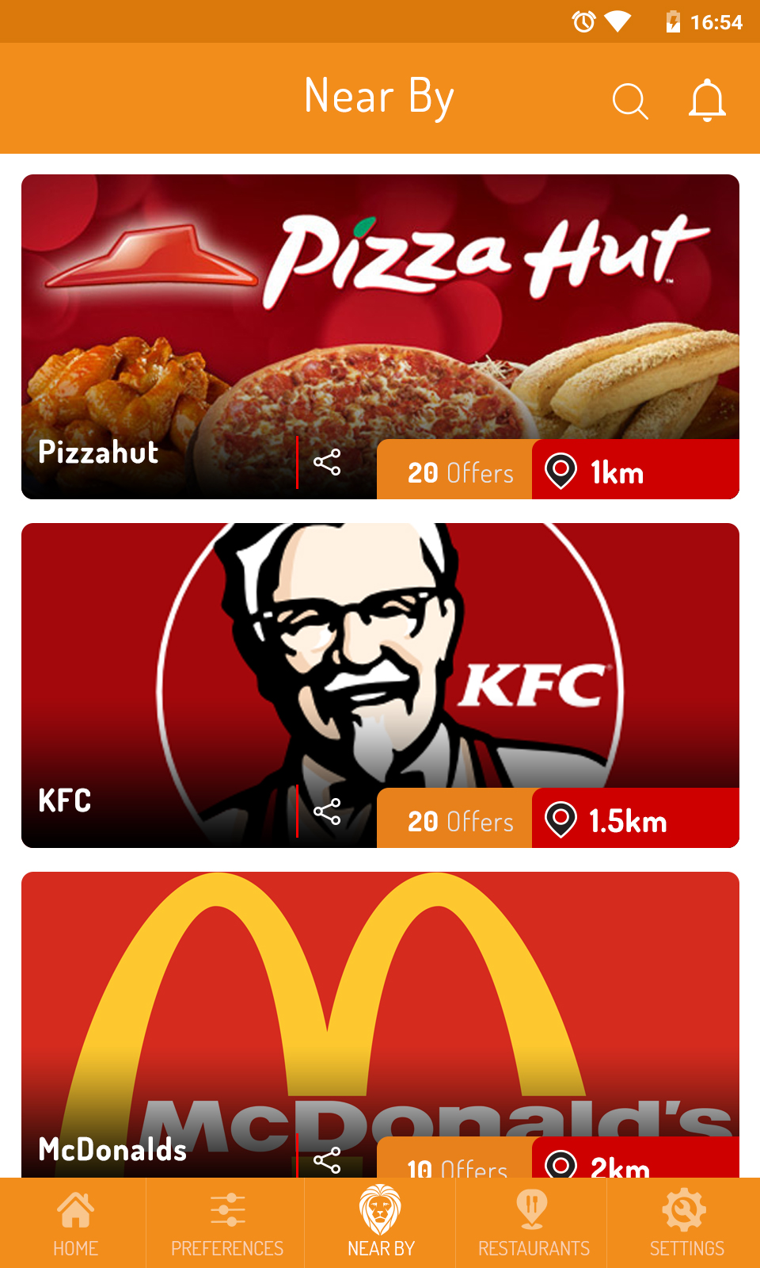
Home Screen
Near By Screen

Slide 8
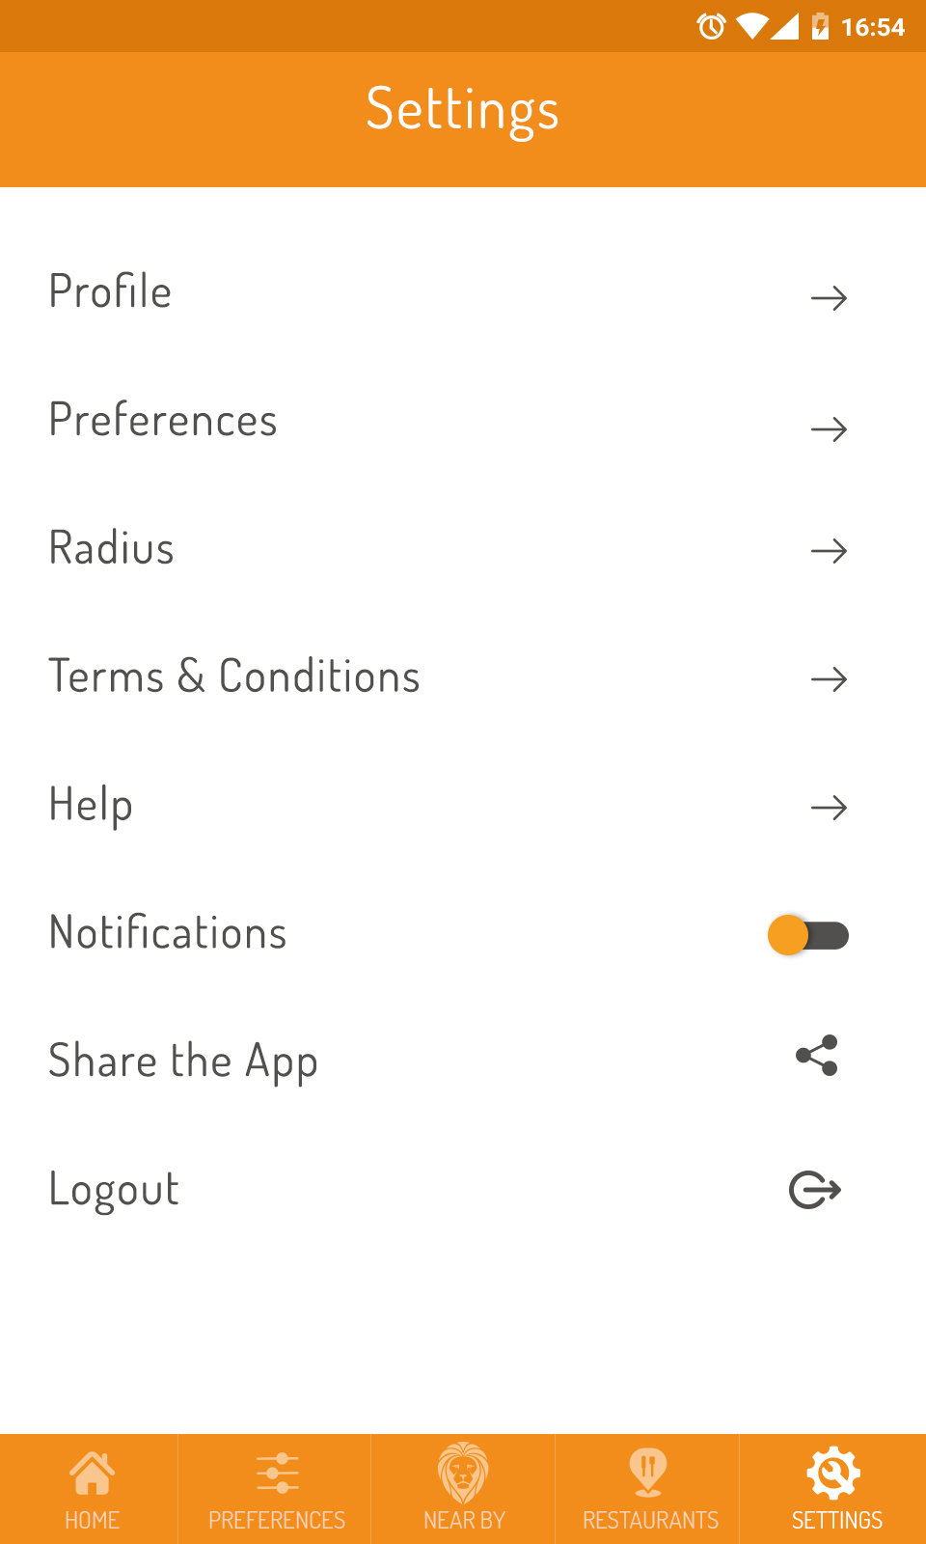
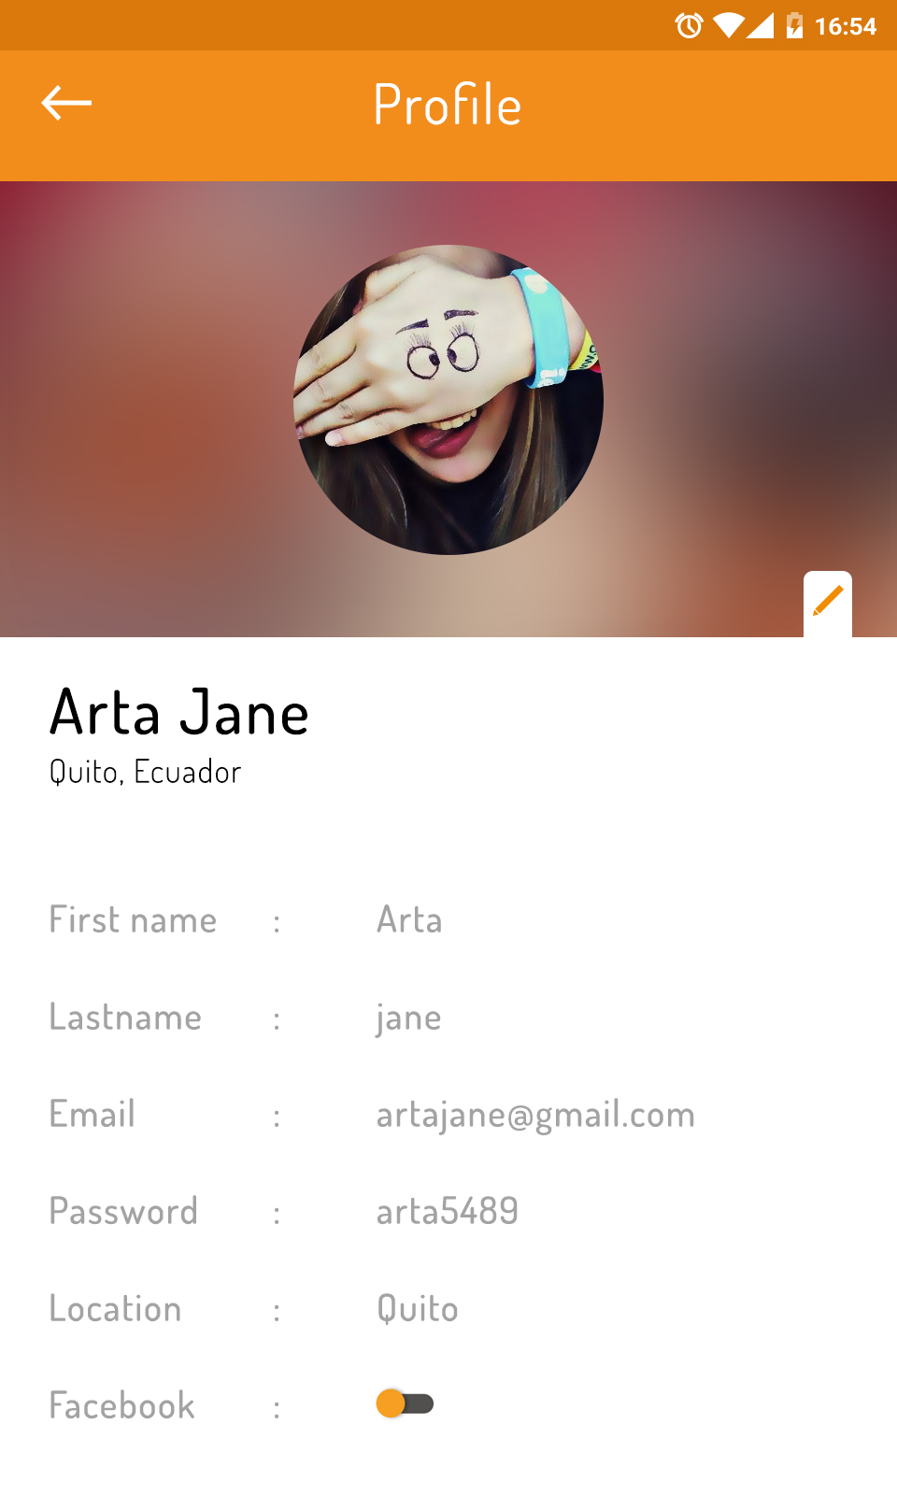
Setting Screen
Profile Screen

Slide 9
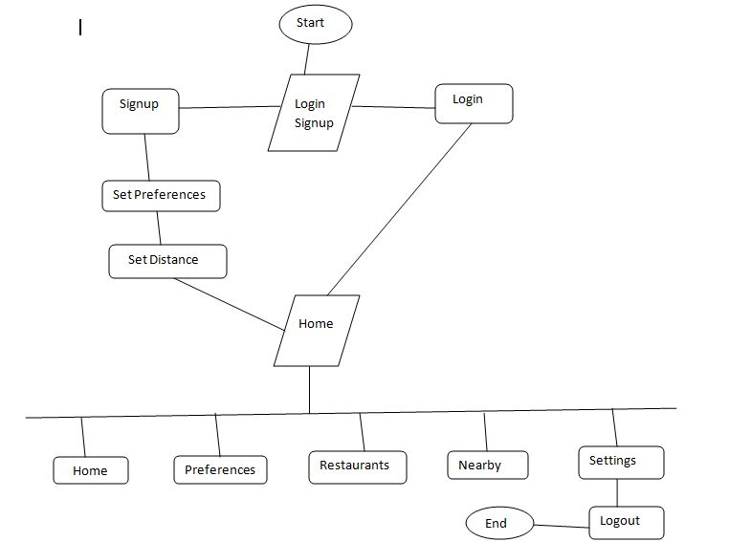
Flow Chart

Slide 10
Advantages
This application will show all the restaurants who is registered for our app.
The advantage of this applications is user without going to the restaurants he will know the all the available food items in that restaurants and it will also show corresponding discounts.
In this application we will show a timer which is used to know when the discount offer will expire.
Based upon preferences(veg , non veg, Ice cream) which user selected it will show the Restaurants.

Slide 11
Disadvantages
In this application user only see near restaurants and discounts. But there is no possibility of ordering or home delivery.
This application is not useful when the restaurant is not registered for our app.
Present our app is only show near 2 km range Restaurants only.

Slide 12
Conclusion
The main aim of this application is to show all the Restaurants near by our location based upon user selected range.
This Application will shows available discounts at Restaurant to the users in timely Manner based on their Preferences.
It has a great potential to engage numerous business owners as well as potential customers in the same place.

Slide 13
Future Implementation
The research process on anything never ends. We keep on going in anything in another way.
As of now we only developed our application only for Food . In Future we will extends it for Shopping (Clothes,Jewellery,Electronic Devises),Sports (Stadiums) and Entertainment purpose (Movie Theaters) and some other purpose and we will add some more futures to our application based upon user reviews.

Slide 14
Thank you

